Slide 1
Malignant Commentes Classifier - Multi Label Classification Project using NLP
By
Mrs. Swati Amit Motugade

Slide 2
Introduction
The increase in penetration of usage of internet services has increased exponentially in the past few years due to the ongoing pandemic, this has empowered an enormous number of dynamic new and old clients utilizing the web for different administrations ranging from academic, entertainment, industrial, monitoring and the emergence of a new trend in the corporate life i.e work-from-home. Due to this sudden emergence of the crowd using the web, there has been an ascent in the number of mischievous persons too.
Now it is the primary task of every online platform provider to keep the conversations constructive and inclusive. The best example can be referred to, can be twitter, a web-based media stage where people share their views. This platform has already drawn a lot of flak because of the spread of hate speech, insults, threat, defamatory acts which becomes a challenge for many such online providers in regulating them. Thus, there is active research being conducted in the field of Toxic comment classification. Here we collate non-identical machine learning and other trivial techniques on the dataset and propose a model that outflanks all others and compares them one-on-one. And the results would help up to create an online interface where we would be able to identify the toxicity level in the given phrase or sentence and classify them into their order of toxicity.

Slide 3
Introduction
The proliferation of social media enables people to express their opinions widely online. However, at the same time, this has resulted in the emergence of conflict and hate, making online environments uninviting for users. Although researchers have found that hate is a problem across multiple platforms, there is a lack of models for online hate detection.
Online hate, described as abusive language, aggression, cyberbullying, hatefulness and many others has been identified as a major threat on online social media platforms. Social media platforms are the most prominent grounds for such toxic behaviour.
There has been a remarkable increase in the cases of cyberbullying and trolls on various social media platforms. Many celebrities and influences are facing backlashes from people and have to come across hateful and offensive comments. This can take a toll on anyone and affect them mentally leading to depression, mental illness, self-hatred and suicidal thoughts.
Internet comments are bastions of hatred and vitriol. While online anonymity has provided a new outlet for aggression and hate speech, machine learning can be used to fight it. The problem we sought to solve was the tagging of internet comments that are aggressive towards other users. This means that insults to third parties such as celebrities will be tagged as unoffensive, but “u are an idiot” is clearly offensive.

Slide 4
Problem Statement
Our goal is to build a prototype of online hate and abuse comment classifier which can used to classify hate and offensive comments so that it can be controlled and restricted from spreading hatred and cyberbullying.

Slide 5
Multi –Label Classification Problem
Difference between multi-class classification & multi-label classification is that in multi-class problems the classes are mutually exclusive, whereas for multi-label problems each label represents a different classification task, but the tasks are somehow related.
For example, multi-class classification makes the assumption that each sample is assigned to one and only one label: a fruit can be either an apple or a pear but not both at the same time. Whereas, an instance of multi-label classification can be that a text might be about any of religion, politics, finance or education at the same time or none of these.
Multi-label classification of textual data is an important problem. Examples range from news articles to emails.
For instance, this can be employed to find the genres that a movie belongs to, based on the summary of its plot.

Slide 6
About Dataset
The data set contains the training set, which has approximately 1,59,000 samples and the test set which contains nearly 1,53,000 samples. All the data samples contain 8 fields which includes ‘Id’, ‘Comments’, ‘Malignant’, ‘Highly malignant’, ‘Rude’, ‘Threat’, ‘Abuse’ and ‘Loathe’.
The label can be either 0 or 1, where 0 denotes a NO while 1 denotes a YES. There are various comments which have multiple labels. The first attribute is a unique ID associated with each comment.
The data set includes:
Malignant: It is the Label column, which includes values 0 and 1, denoting if the comment is malignant or not.
Highly Malignant: It denotes comments that are highly malignant and hurtful.
Rude: It denotes comments that are very rude and offensive.
Threat: It contains indication of the comments that are giving any threat to someone.
Abuse: It is for comments that are abusive in nature.
Loathe: It describes the comments which are hateful and loathing in nature.
ID: It includes unique Ids associated with each comment text given.
Comment text: This column contains the comments extracted from various social media platforms.

Slide 7
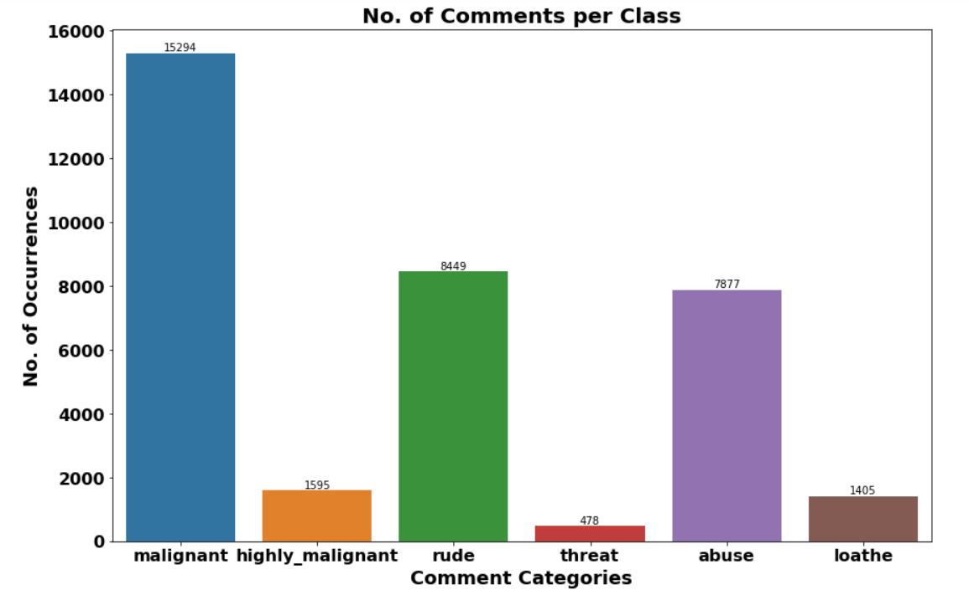
Class wise Distribution of Comments
Out of total Negative comments the maximum negative comments come with Malignant in nature followed by rude categories.
Around 90% comments are Good/Neutral in nature while rest 10% comments are Negative in nature.
Very few comments come with threatening nature.

Slide 8
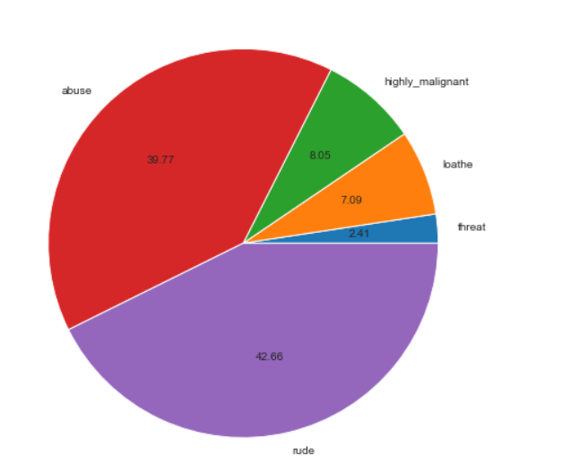
Label Distribution over Comments
Around 90% comments are Good/Neutral in nature while rest 10% comments are Negative in nature.
Out of total negative comments around 43.58% are malignant in nature followed by 24.07% are rude comments.

Slide 9
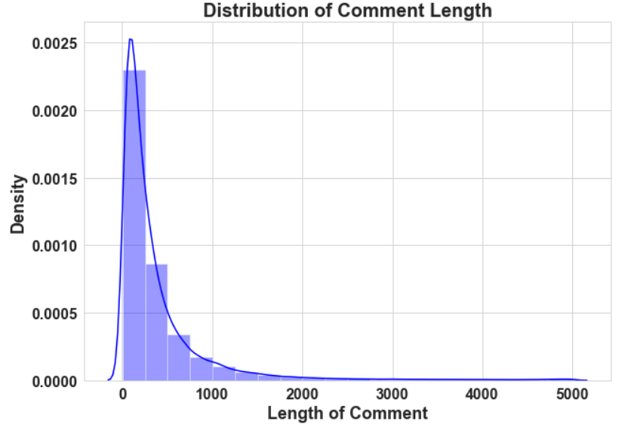
Distribution of Comment Length
The plot shows the comment length frequency. As noticed, most of the comments are short with only a few comments longer than 1000 words.
Majority of the comments are of length 500, where maximum length is 5000 and minimum length is 5. Median length being 250.

Slide 10
Data Pre Processing
Convert the text to lowercase
Remove the punctuations, digits and special characters
Tokenize the text, filter out the adjectives used in the review and create a new column in data frame
Remove the stop words
Stemming and Lemmatising
Applying Text Vectorization to convert text into numeric

Slide 11
Multi-Label Classification Techniques
One Vs Rest
Binary Relevance
Classifier Chains
Label Powerset
Adapted Algorithm

Slide 12
Word Cloud for getting word sense
Word Cloud is a visualization technique for text data wherein each word is picturized with its importance in the context or its frequency.
The more commonly the term appears within the text being analysed, the larger the word appears in the image generated.
The enlarged texts are the greatest number of words used there and small texts are the smaller number of words used.

Slide 13
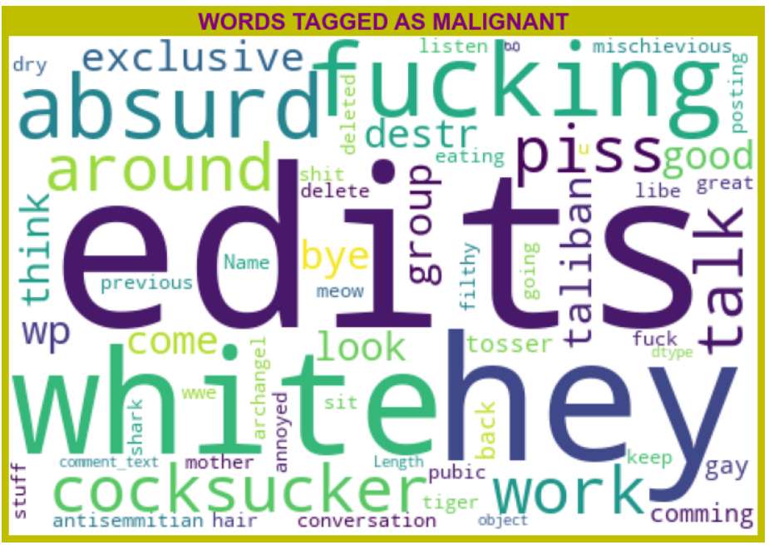
Word Cloud for WORDS TAGGED AS Malignant
From wordcloud of malignant comments, it is clear that it mostly consists of words like edits, hey, white, fucking, gay, cocksucker, work, think, taliban etc.

Slide 14
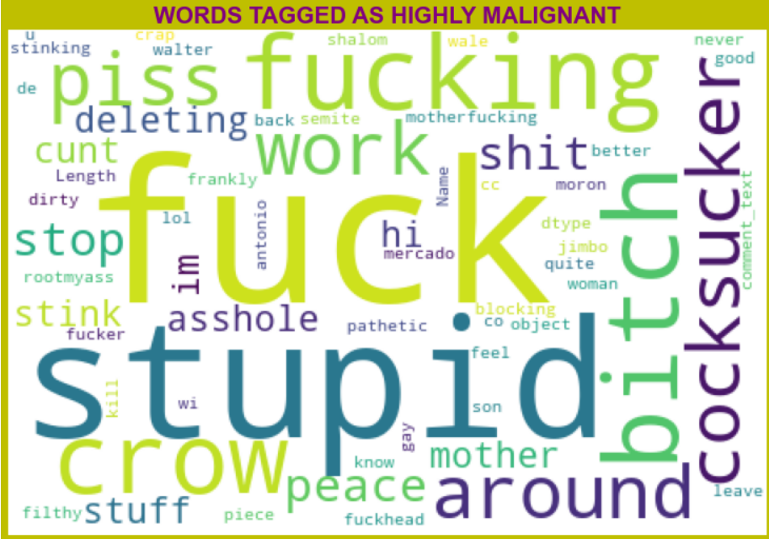
Word Cloud for WORDS TAGGED AS highly Malignant
From wordcloud of Highly malignant comments, it is clear that it mostly consists of words like fuck, stupid, fucking, bitch, crow, shit, cocksucker etc.

Slide 15
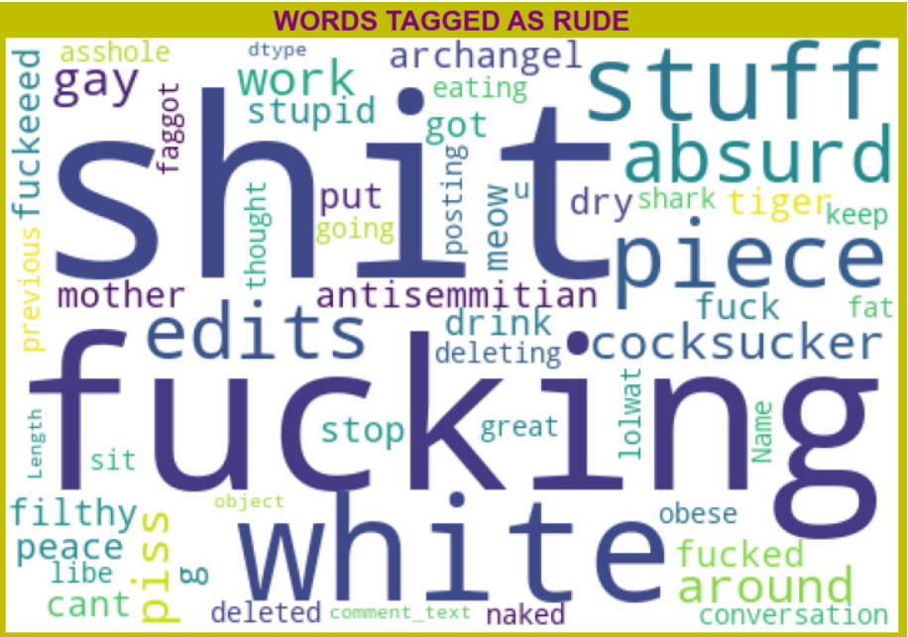
Word Cloud for WORDS TAGGED AS Rude
From wordcloud of Rude comments, it is clear that it mostly consists of words like fucking, shit, white, piece, edits, stuff, absurd etc.

Slide 16
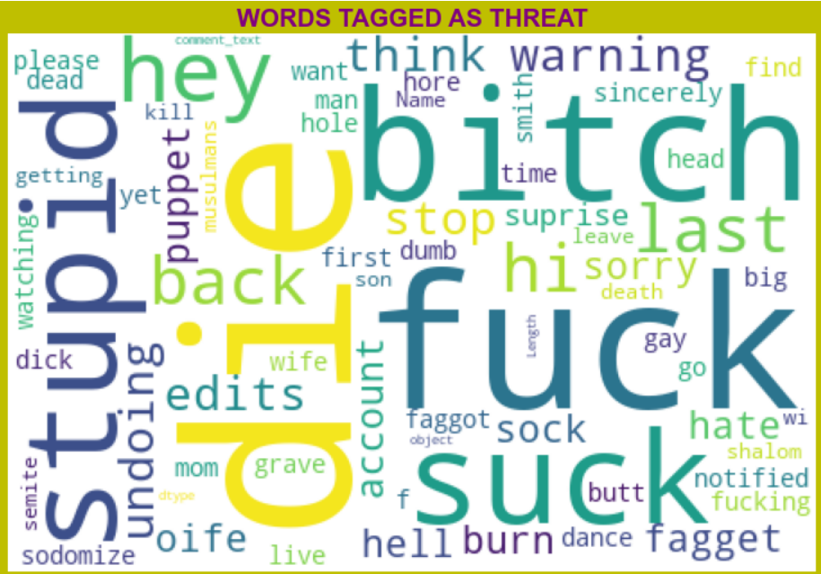
Word Cloud for WORDS TAGGED AS Threat
From wordcloud of Threat comments, it is clear that it mostly consists of words like fuck, suck, Bitch, die, stupid, etc

Slide 17
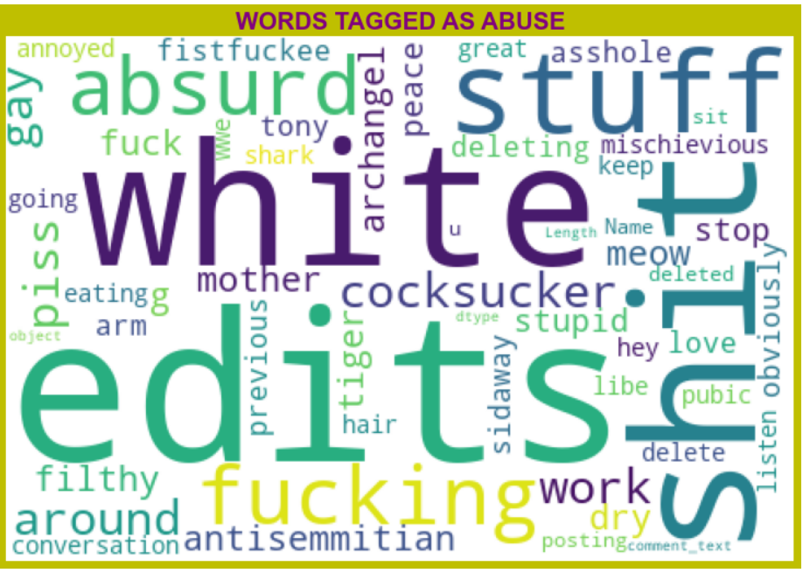
Word Cloud for WORDS TAGGED AS Abuse
From wordcloud of Abuse comments, it is clear that it mostly consists of words like edits, white, shit, stuff, fuck, piss, fucking etc.

Slide 18
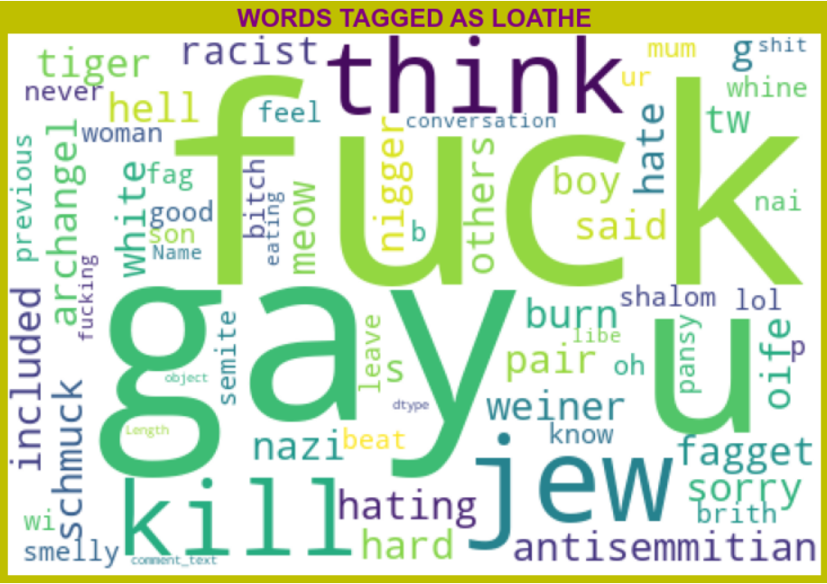
Word Cloud for WORDS TAGGED AS loathe
From wordcloud of Loathe comments, it is clear that it mostly consists of words like fuck, gay, kill, think, jew, u etc.

Slide 19
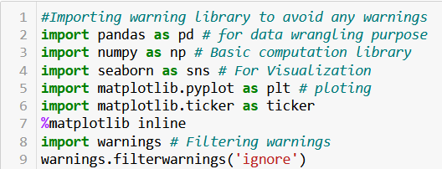
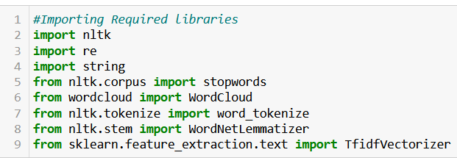
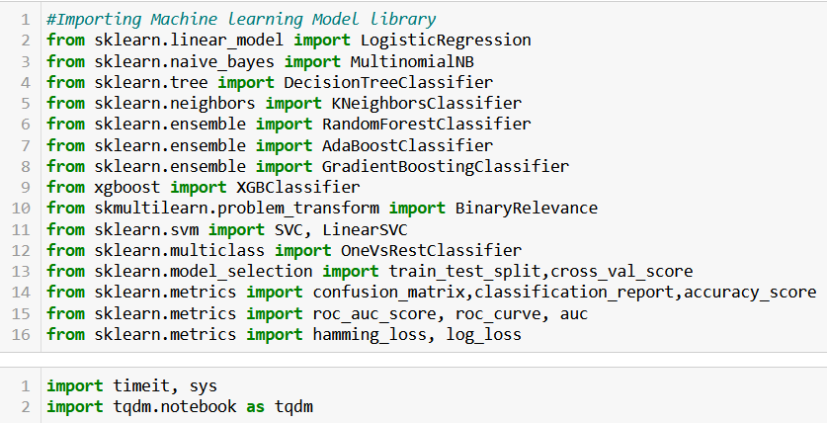
Libraries Imported
Visualization & Data
Wrangling Library used
Text Mining
Machine Learning Model
Building Library used

Slide 20
Machine Learning Model Building
The different classification algorithm used in this project to build ML model are as below:
Random Forest classifier
Support Vector Classifier
Logistics Regression
AdaBoost Classifier

Slide 21

Machine Learning Evaluation Matrix
Support Vector Classifier gives maximum Accuracy Score: 91.1508 % and Hamming Loss: 2.0953% than the other classification models.
Hyper parameter Tuning is perform over this best model using best param shown below :

Slide 22
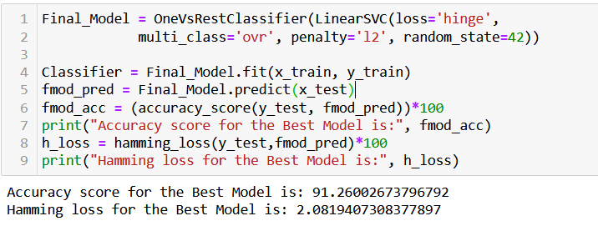
Final ML Model
Final model gives accuracy score as 91.26% which is slightly improved as compared to previous accuracy score 91.15%.

Slide 23
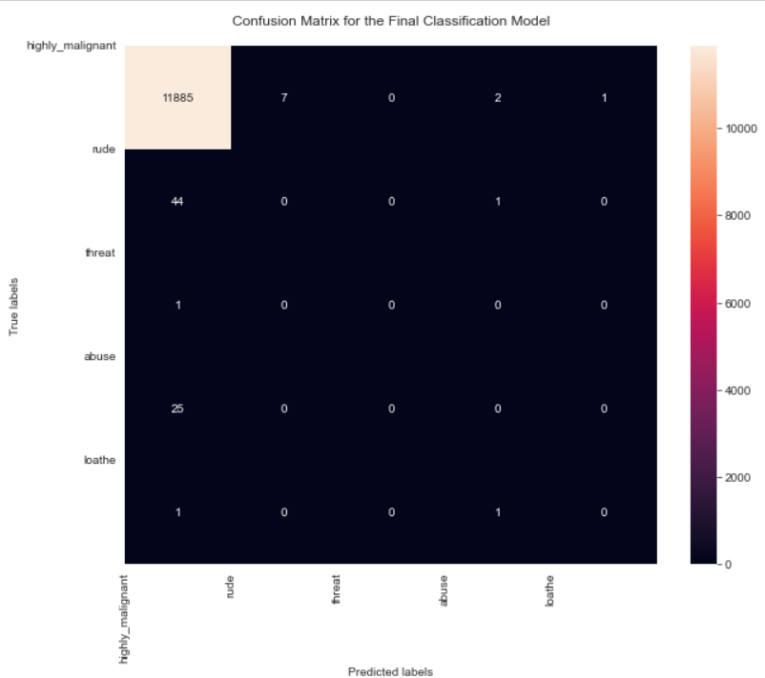
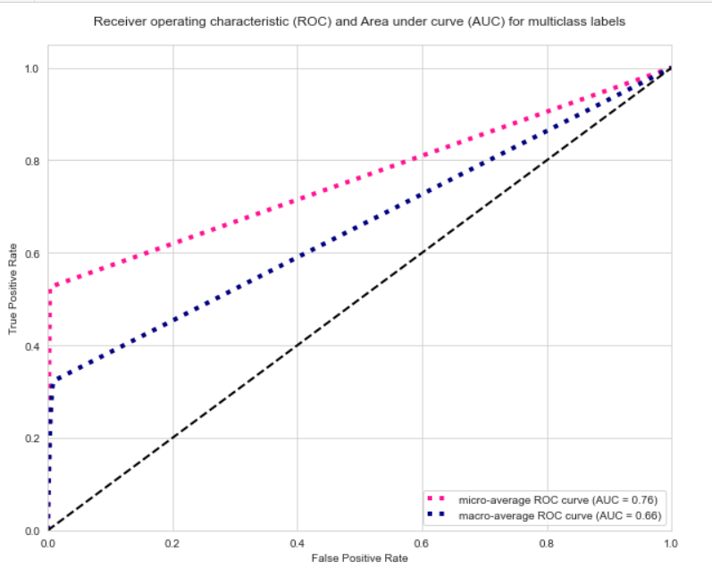
AUC-ROC Curve and Confusion Matrix

Slide 24
Machine Learning Evaluation Matrix
Algorithm | Accuracy Score | Precision (Micro) | Recall (Micro) | F1 Score (Micro) | Hamming Loss
Logistic Regression | 0.9123433 | 0.89 | 0.47 | 0.61 | 0.0220660
Random Forest Classifier | 0.9073300 | 0.79 | 0.56 | 0.66 | 0.021977
Support Vector Classifier | 0.9115077 | 0.82 | 0.56 | 0.67 | 0.0209520
Ada Boost Classifier | 0.9057349 | 0.80 | 0.50 | 0.61 | 0.0234460

Slide 25
CONCLUSION
Linear Support Vector Classifier performs better with Accuracy Score: 91.15077857956704 % and Hamming Loss: 2.0952019242942144 % than the other classification models.
Final Model (Hyperparameter Tuning) is giving us Accuracy score of 91.26% which is slightly improved compare to earlier Accuracy score of 91.15%.
SVM classifier is fastest algorithm compare to others.

Slide 26
Limitations of this work and Future Scope
The Maximum feature used while vectorization is 2000. Employing more feature in vectorization lead to more accurate model which I not able to employed due computational resources.
Data is imbalanced in nature but due to computational limitation we have not employed balancing techniques here.
Deep learning CNN, ANN can be employed to create more accurate model.

Slide 27
Thank You

